Slide 1

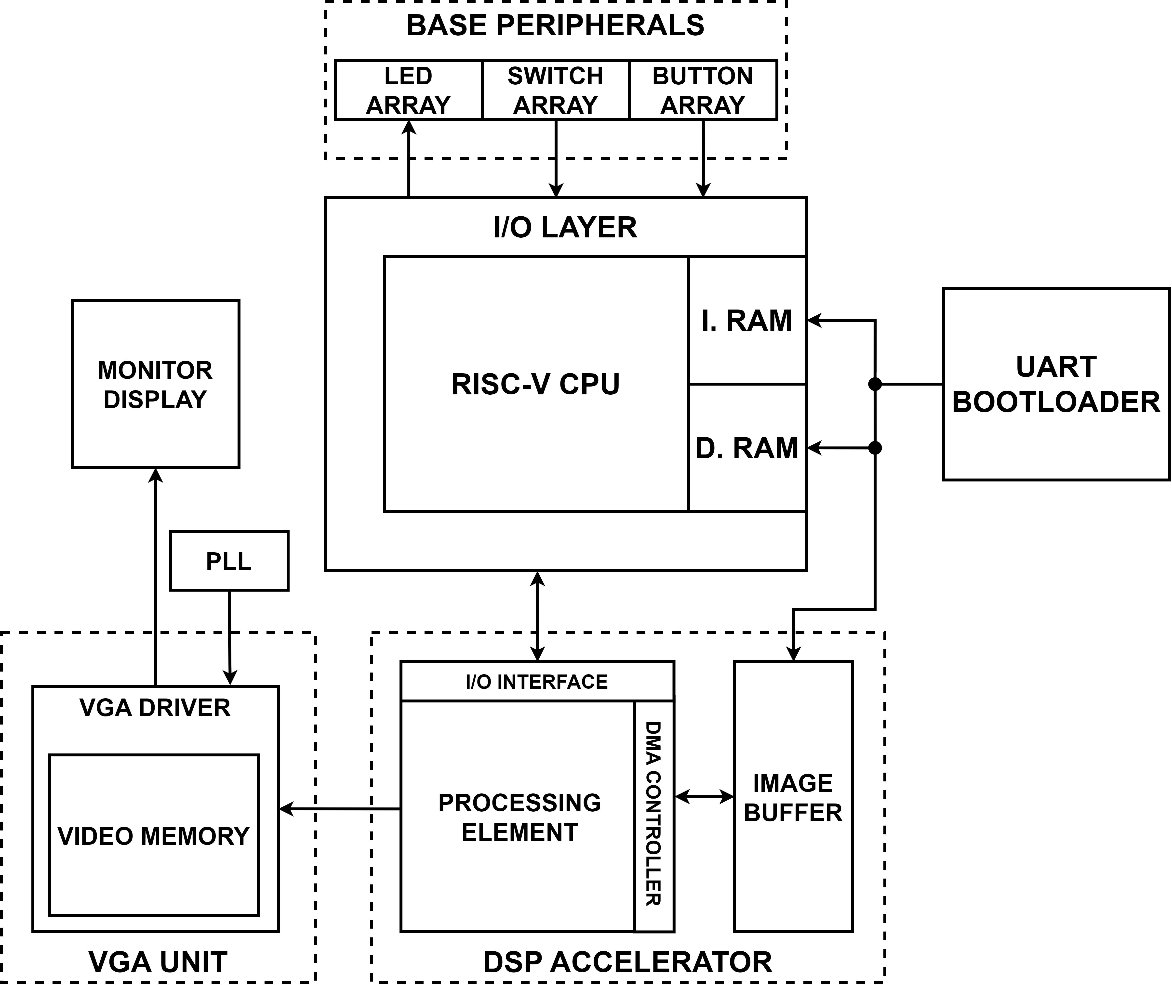
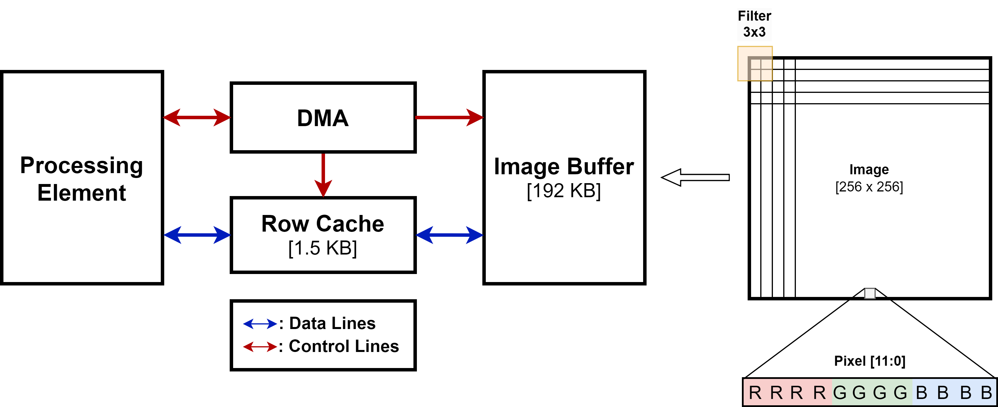
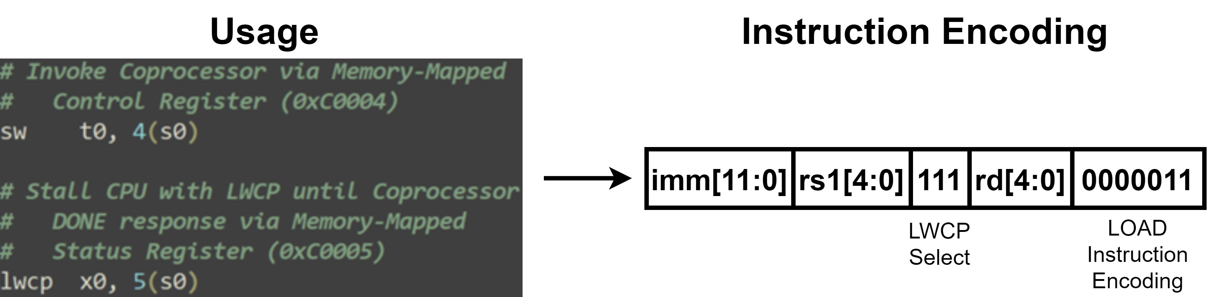
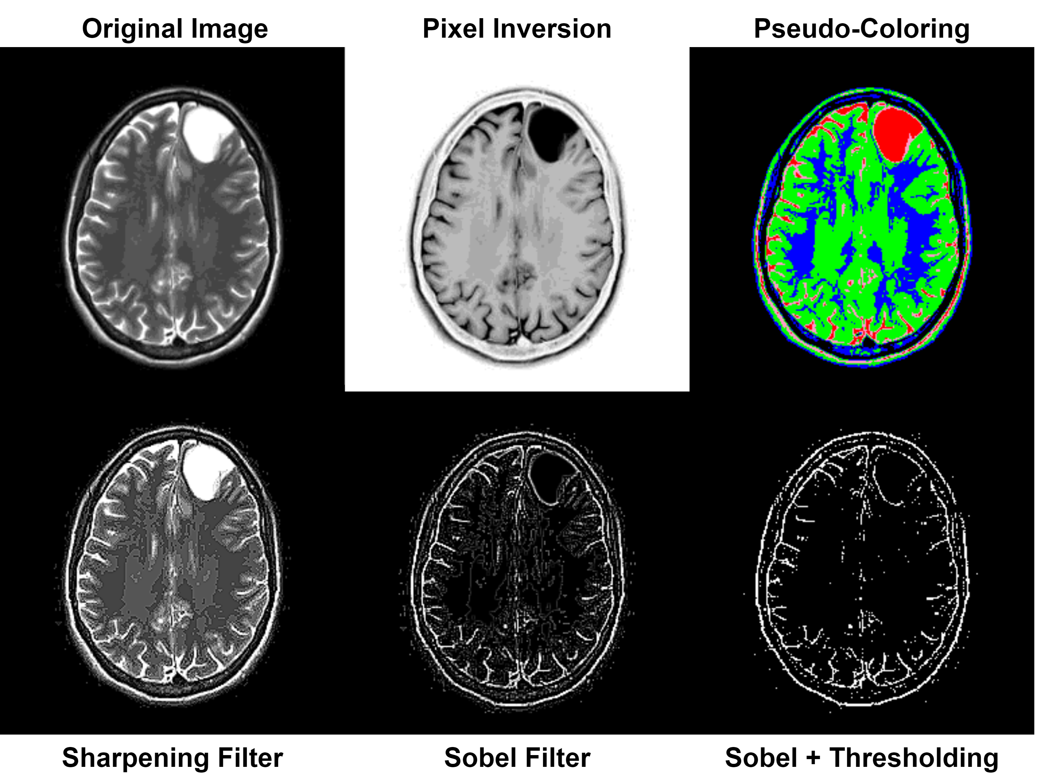
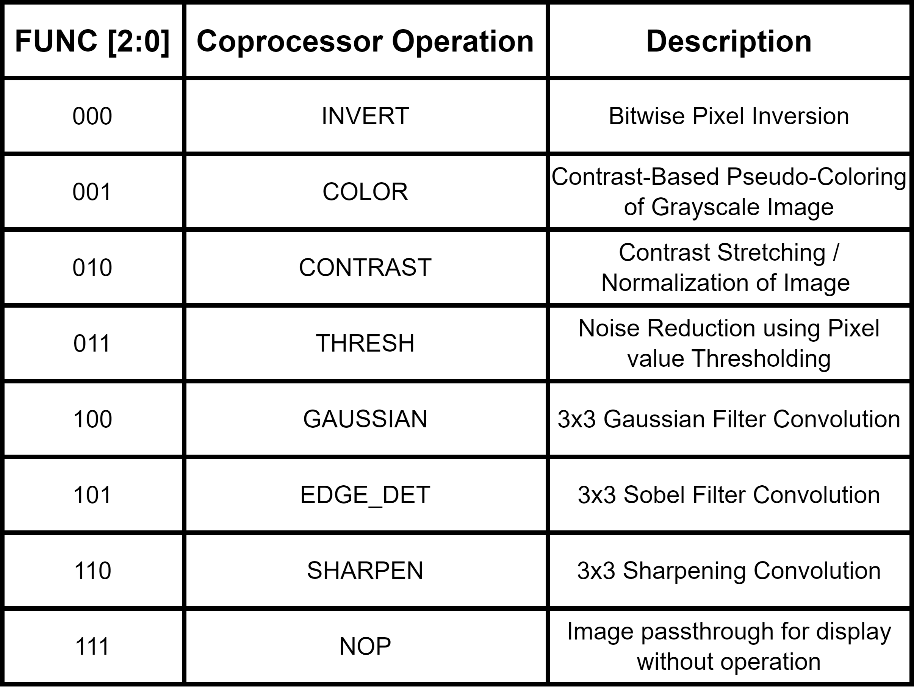
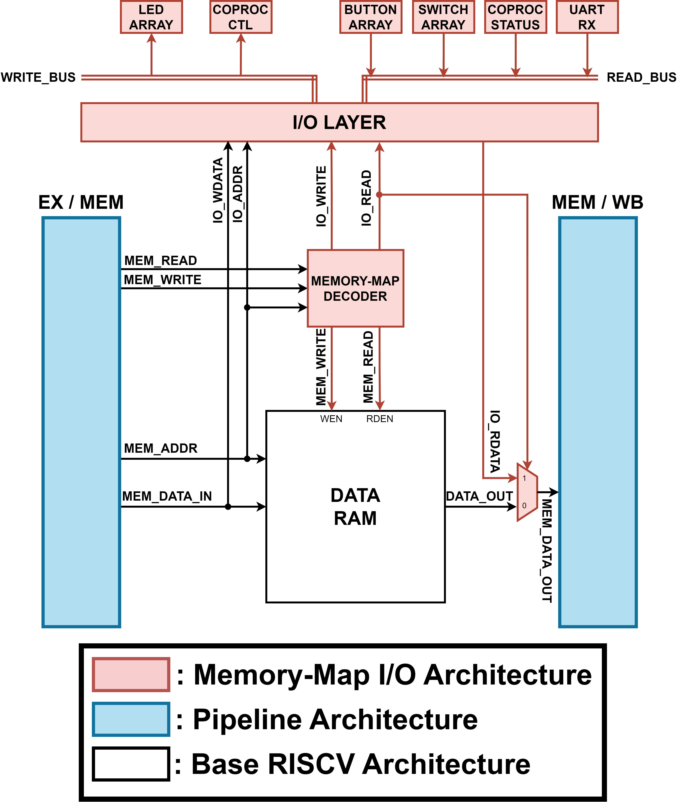
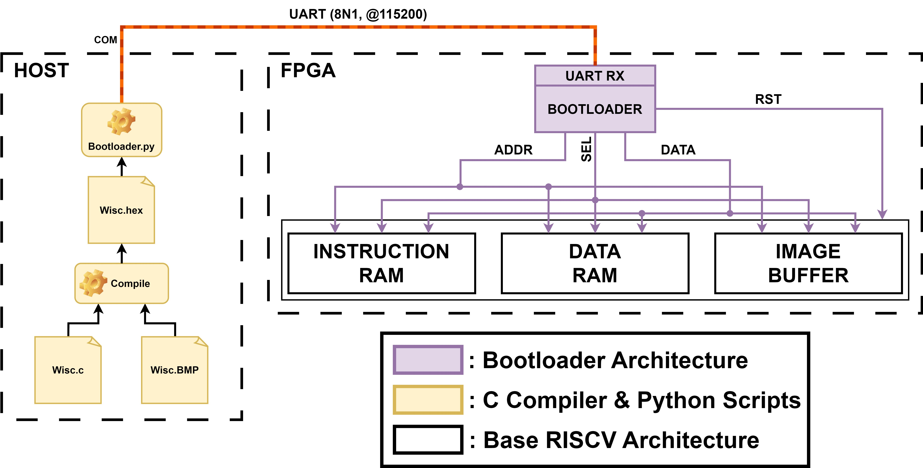
ECE 554
Alvin & The Chip-Monks
Ashwin K. Avula
Yucheng Chang
Garry Chen
Alvin Cheng
Project Description
Image Coprocessor Architecture
RISC-V ISA Extension for Coprocessor Support
Overview:
Implementation of a General-Purpose 32-Bit RISC-V CPU and dedicated DSP Coprocessor for acceleration of common image-processing tasks on an Altera DE-1 FPGA
Independent Image & Video memories for efficient storage, access, and visualization of 256x256 4-Bit RGB Images
Custom UART Bootloader system allowing for reprogramming of all device memories, avoiding frequent compilation of the FPGA
Memory-aware design for full utilization of fast
FPGA on-chip Block SRAM
Image Buffer & Storage Format:
Image Buffer allowing for fast dual-port access, while maximizing utilization of FPGA M10K Banks
Pixel data streaming from Image Buffer by DMA, and cached for optimal data reuse in Processing Element
Image Data Prefetching into Row Cache by DMA, thus reducing Processing Element stalls
Dedicated Load-Word-Coprocessor (LWCP) Instruction:
Behavior: LWCP behaves like a LW Instruction, however upon reaching the MEM stage, LWCP stalls upstream stages until Coprocessor returns DONE response
Usage: LWCP instruction must follow a SW instruction that invokes the Memory-Mapped Coprocessor, ensuring that the CPU will receive a DONE response in the future
Figure 7: Usage & Encoding for Dedicated LWCP Instruction
Figure 5: Direct Memory Access (DMA) Controller and Coprocessor Dataflow
Validation & Application
Figure 1: Top-Level Device Components
Verification:
Complete CPU verification in RISC-V toolchain environment
Coprocessor verification by comparing expected output generated in Python with accelerator output images
Software: C and Assembly programs written for performing all operations using CPU-Only, CPU + Coprocessor, and CPU + Coprocessor + LWCP Instruction device combinations
Application: Operations performed on various 256x256 RGB and grayscale medical images
Implementation: Deployed onto Altera DE-1 FPGA @ 50MHz and image output to Monitor display via VGA driver
RISC-V Base 32-I Core Architecture
Features:
32x32b Register File supporting Register File Bypassing
Harvard Memory Model (8 KB Instruction + 8 KB Data RAMs)
Byte-Addressable Data Memory supporting Byte, Halfword, Word Accesses
Execute→Execute, Memory→Execute, Memory→Memory, and Execute→Decode Forwarding
Branch & Jump handling in DECODE for reduced STALL cycles
Figure 8: Example Coprocessor Output
Discussion
Results:
Implementation of Coprocessor resulted in significant program speedup, reduced application code, and less traffic to Memory
Figure 6: Primary Accelerator Processing Element
Figure 2: Top-Level Pipelined RISC-V Data & Control Flow
Accelerator Processing Element:
Primary Processing Element containing RGB→Gray Conversion, Convolution, and Basic Compute Units
Single-Cycle compute allowing for calculation of an output pixel per cycle
Fixed channel-wise convolutional array for 3x3 Filters, Stride = 1
Output of Processing Element written into VGA Video memory for display and into Row Cache for Image Buffer writeback
CPU Memory-Mapped I/O & UART Bootloader
Figure 9: CPU + Accelerator Cycle Speedup Compared to CPU-Only Operation
Implementation of LWCP Instruction avoids polling of Coprocessor Memory-Mapped Registers, and stalling allows for idling of CPU, thus reducing application code and minimizing CPU Dynamic Power Consumption during Coprocessor operation
UART Bootloader allowed for on-the-fly programming of any device memory, avoiding frequent inefficient recompilation of device and memory onto FPGA
Table 1: Supported Coprocessor Operations
Future Improvements:
Image compression in hardware allowing for storage of images with greater resolution
Programmable convolutional array allowing for Convolutional Neural Network inferencing on Coprocessor
Figure 4: Bootloading Workflow for Memory Loading
Figure 3: Top-Level I/O Layer Interface with CPU Memory Stage
ECE Capstone Open House 2024

